Slide 1
Topic 9 – Similarity, Nearest Neighbors, and Clustering
Data Science for Business
Prof: Chris Volinsky
NYU Stern: Spring 2025

Slide 2
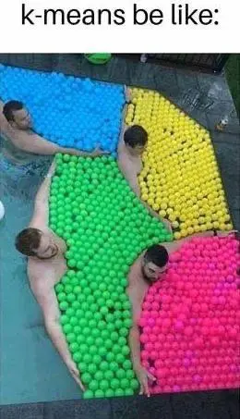
This Chapter
Similarity
How to define similarity through data
K-Nearest Neighbors (kNN)
Using similarities to build a classifier
Clustering
Unsupervised learning using similarities to group data instances
DSB
Chapter 6 - Similarity, Neighbors and Clusters
Shmueli
Chapter 7 – k-Nearest Neighbors
Chapter 15 - Clustering

Slide 3
Similarity

Slide 4

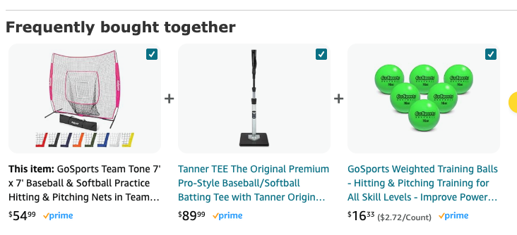
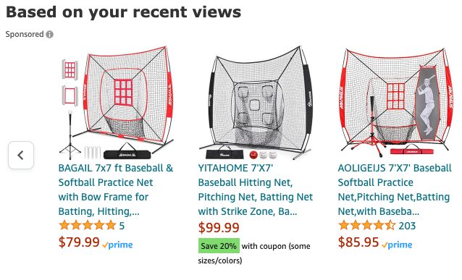
Similarity
The concept of similarity underlies many data science methods and solutions to business problems
Idea: If two things are similar in some ways, they often share other characteristics as well
Think about how similarity is used in retail:
Notes:
Products can be similar
Products can be bought together
People can be similar
How does similarity work in retail?

Slide 5
Similarity and Distance
Similarity can be used for many different data science and business activities
Find similar products to existing products to identify recommendations
E.g. IBM – many products / many clients
recommender systems
DSB whisky example
Identify items/customers who are similar to your known best customers..
What patterns identify our best customers? Find new ones early
Similarity for classification or regression
Use information about similar customers to make predictions about new customers (“nearest neighbors”)
Use similarities to group similar items into clusters
Unsupervised learning

Slide 6





Similarity (and distance…)
Remember the credit card example??
We need a metric to define how similar any two customers are
Customer | Age | Income | No. credit cards | Response
John | 35 | 35K | 3 | Yes
Charlene | 22 | 50K | 2 | No
Rayshawn | 63 | 200K | 1 | No
Ping | 59 | 170K | 1 | No
Nellie | 25 | 40K | 4 | Yes

Slide 7
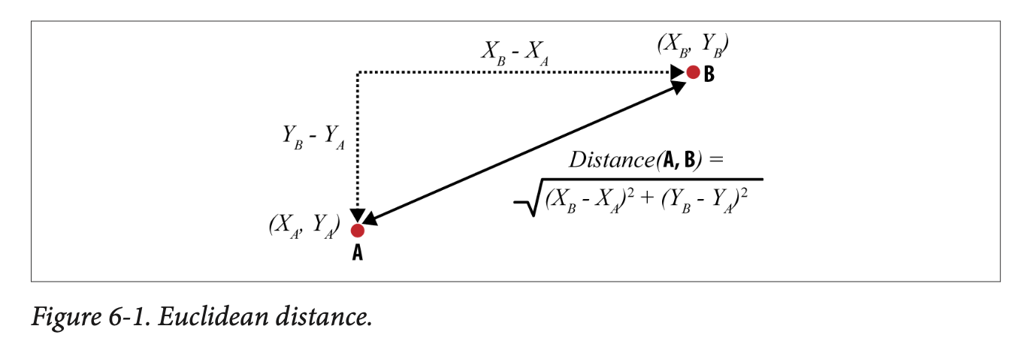
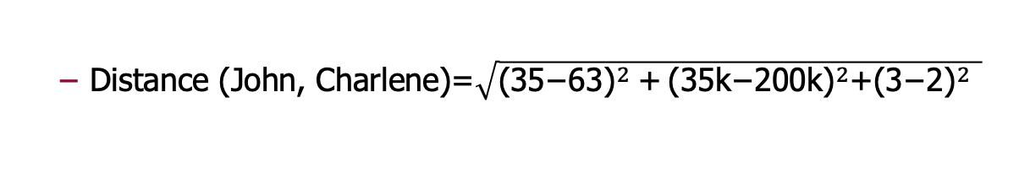
Similarity/distance
Customer | Age (X₁) | Income (X₂) | No. credit cards (X₃) | Response (Y)
John | 35 | 35K | 3 | Yes
Rayshawn | 63 | 200K | 1 | No
“Closeness” is defined in terms of the distance between two data items.
The most common numeric difference is Euclidean distance:
The Euclidean distance between
X₁=(x₁₁, x₁₂, x₁₃,…x_{1k}) and X₂=(x₂₁, x₂₂, x₂₃,…x_{2k})
Distance (John, Charlene)=$\sqrt{{\text{(35−}\text{63}\text{)}}^{2} \text{+}{ \text{(35}\text{k}\text{−2}\text{00}\text{k}\text{)}}^{2}\text{+}{\text{(3−2)}}^{2} }$
Do you see any issue with calculating distance this way?

Slide 8
Caution using Euclidean Distance
Customer | Age | Income | No. credit cards | Response
John | 35 | 35K | 3 | Yes
Rayshawn | 63 | 200K | 1 | No
Euclidean distance is often the default that is used for distances in software
BUT, they are very sensitive to the scale of the data used
Distance (John, Rayshawn)=sqrt [(35-63)² + (35,000-200,000)² + (3-1)²]
Distance between neighbors will be dominated by attributes with relatively large values
Goal: Each attribute should have the same “weight”
Solution: Normalize numeric variables – two standard ways to do this
Scale data between 0(min) and 1(max)
Create z-scores by subtracting mean and dividing by standard dev
New feature will have mean = 0 and sd =1
from sklearn.preprocessing import MinMaxScaler
from sklearn.preprocessing import StandardScaler
Notes:
And to take logs, for long-tail distributions (in our case, we divided by 1000)

Slide 9
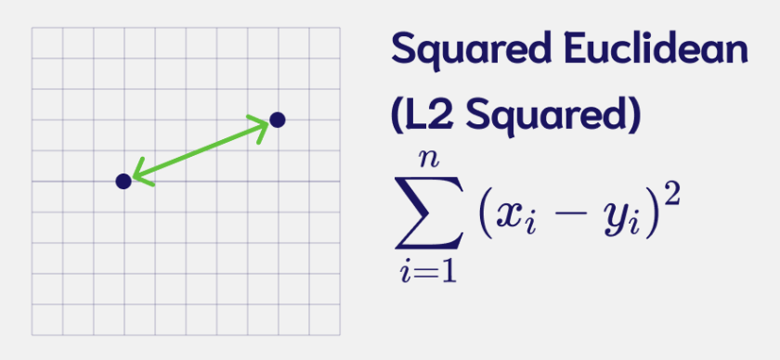
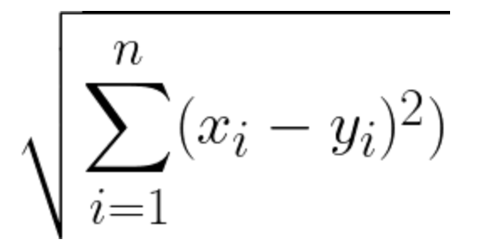
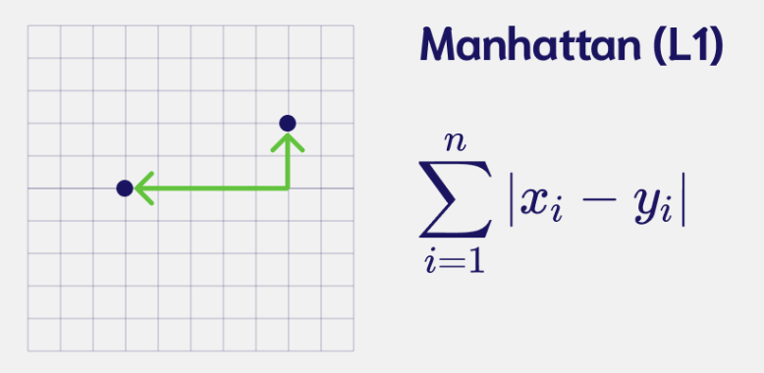
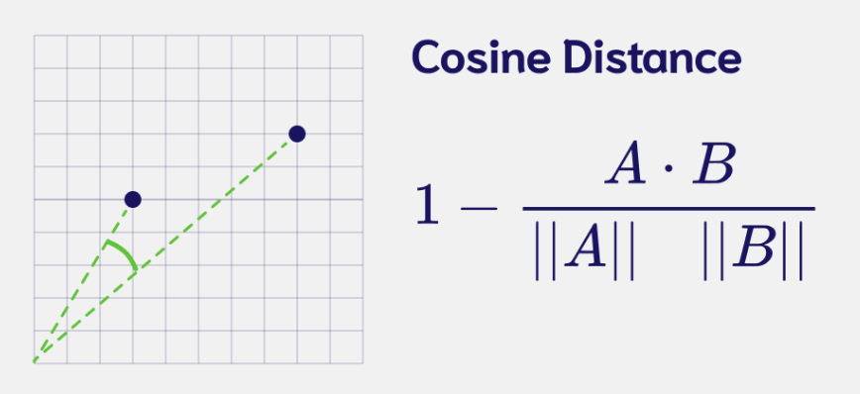
Different types of similarity/distances
Euclidean
Squared differences
Manhattan
Absolute differences
Less sensitive to outliers
Often used with many dimensions
Cosine
Often used in text analysis, sparse data
Direction more important than magnitude

Slide 10
K-Nearest Neighbors (kNN)

Slide 11
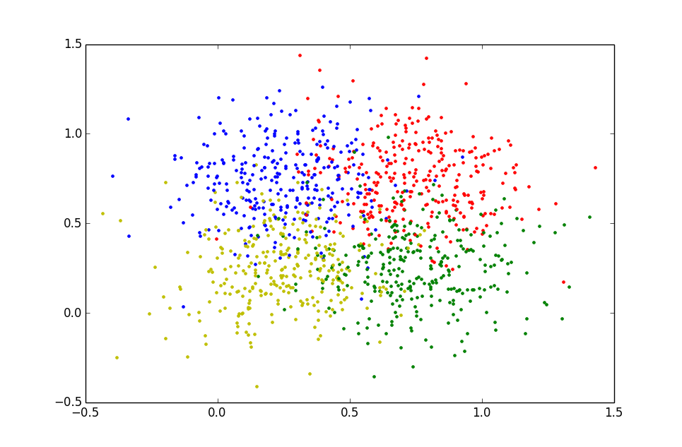
Nearest Neighbors: The idea
K-Nearest Neighbors (kNN) is a classification algorithm that ignores global structure and simply looks at similarities
I don’t know anything about this new customer…but if I can find their “neighbors” I might be able to infer something…

Slide 12

Using similarity for classification
Customer | Age | Income | No. credit cards | Response
John | 35 | 35K | 3 | Yes
Charlene | 22 | 50K | 2 | No
Rayshawn | 63 | 200K | 1 | No
Ping | 59 | 170K | 1 | No
Nellie | 25 | 40K | 4 | Yes
Jalen | 37 | 50K | 2 | ?
Notes:
Concptionslly the idea is easy…who is he most similar to and use that to make a predictions

Slide 13
Nearest Neighbors for Classification
To determine the class of a new example (Jalen):
Calculate the distance between Jalen and all examples in the training set
Select k examples closest to Jalen in the training set
Assign Jalen to the most common class* among its k nearest neighbors
yes
Similarity rank =2
Similarity rank =4
no
Similarity rank =1
yes
Prediction for Jalen = yes
Similarity rank =5
Similarity rank =3

Slide 14
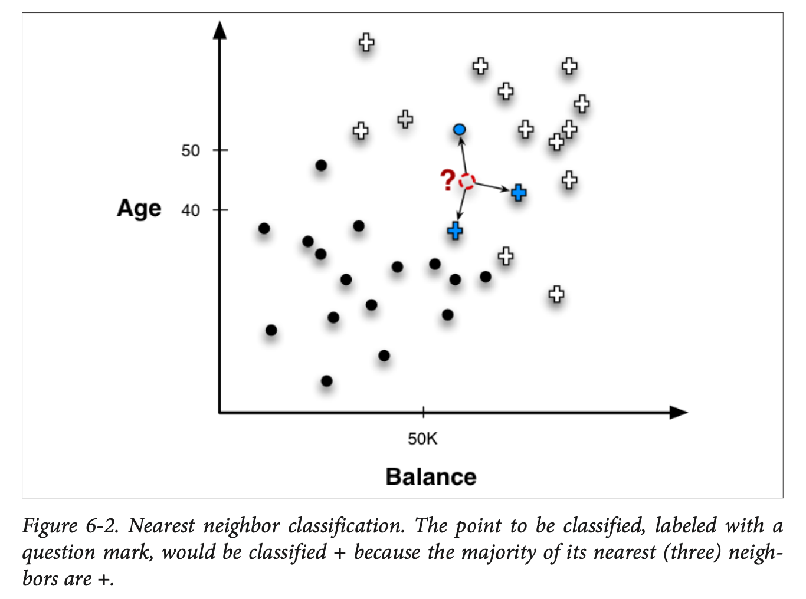
K-nearest neighbors
This is called “k-nearest-neighbors” or kNN classification
Note that your answer will depend on the k that you choose

Slide 15
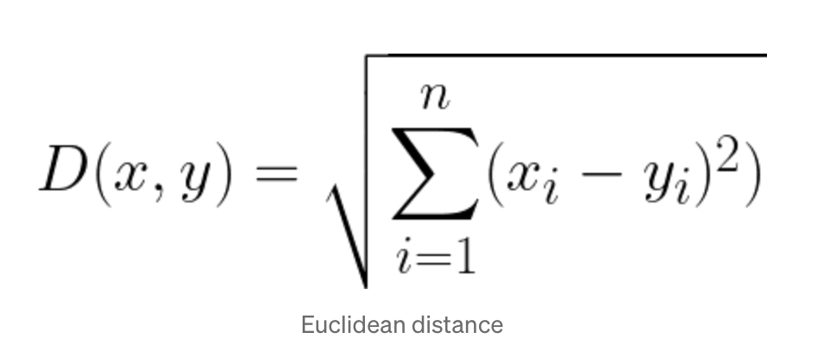
Example: K=1
Normalized data…
Customer | Age | Income (K) | No. cards
John | -0.30 | -0.81 | 0.61
Charlene | -0.98 | -0.62 | -0.15
Rayshawn | 1.16 | 1.27 | -0.92
Ping | 0.95 | 0.89 | -0.92
Nellie | -0.83 | -0.74 | 1.38
Jalen | -0.20 | -0.62 | -0.15
Response
Yes
No
No
No
Yes
?
Distance from Jalen
0.80
0.78
2.45
2.05
1.66
NO (1/1)

Slide 16
Example: K=3
Customer | Age | Income (K) | No. cards
John | -0.30 | -0.81 | 0.61
Charlene | -0.98 | -0.62 | -0.15
Rayshawn | 1.16 | 1.27 | -0.92
Ping | 0.95 | 0.89 | -0.92
Nellie | -0.83 | -0.74 | 1.38
Jalen | -0.20 | -0.62 | -0.15
Response
Yes
No
No
No
Yes
?
Distance from Jalen
0.80
0.78
2.45
2.05
1.66
Yes (2/3)

Slide 17
K-nearest neighbors
Strengths
Simple to implement and use
Interpretable – easy to explain
easy to add data
Weakness
Results are dependent on selection of k, distance function, and scaling
Probability estimates less useful (precise) than other methods
Considerations
What k is optimal?
What if k=N?
What if k=1?
Notes:
K = n you predict the majority class for everybody
K=1 you have a lot of variance…
Which one has the most complexity

Slide 18
Geometric interpretation
Age
X
How would you classify these X values?
40
X
X
100K
Income
Notes:
K=1 vs 3 might be different…

Slide 19
How does a 1-nearest-neighbor classifier partition the space?
Age
Question: Which is more complex, higher or lower k??
40
100K
Income

Slide 20
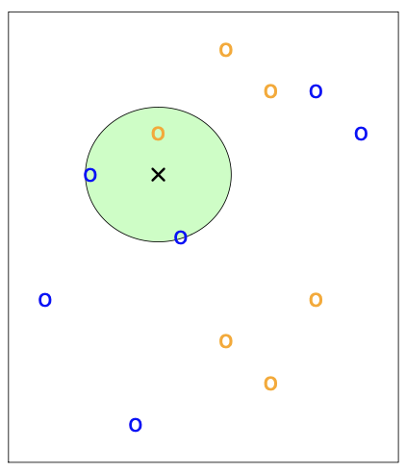
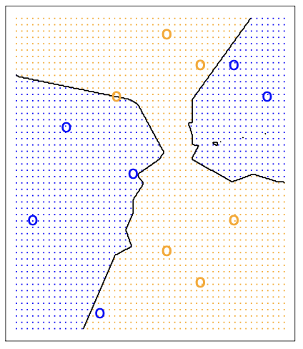
kNN – Decision Boundaries
k=3 nearest neighbors
Decision boundary for k=3

Slide 21
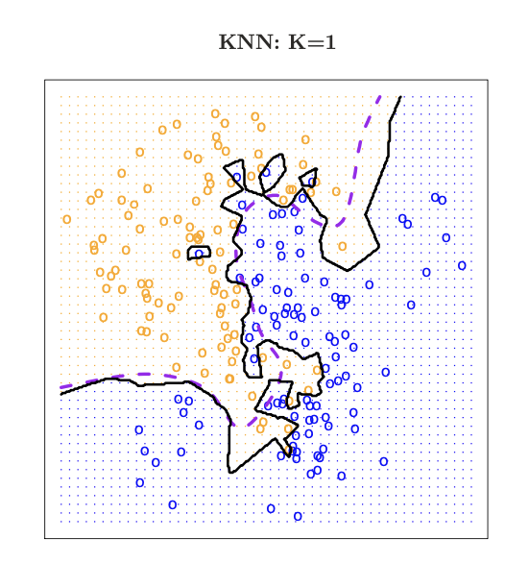
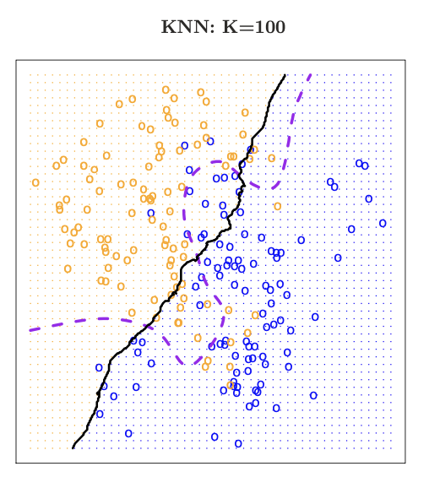
kNN and Complexity
Dashed line is the best answer based on knowing how the data was simulated
K is a complexity parameter
Small k tends to overfit the data
ISL Chap 2.2

Slide 22
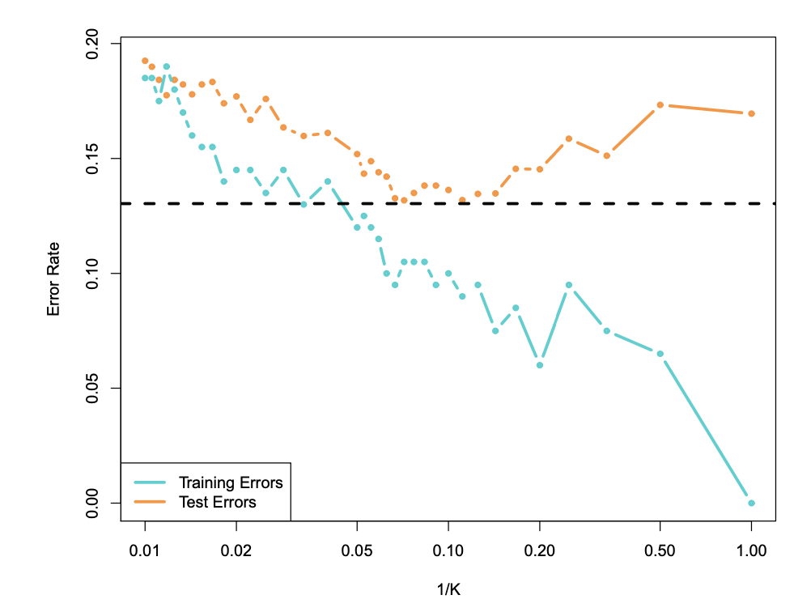
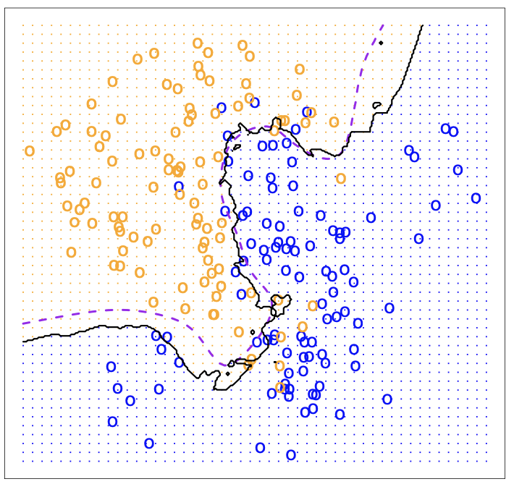
Optimizing k though cross-validation
k=10
Because high values of k correspond to low complexity, we use 1/k as the X-axis

Slide 23
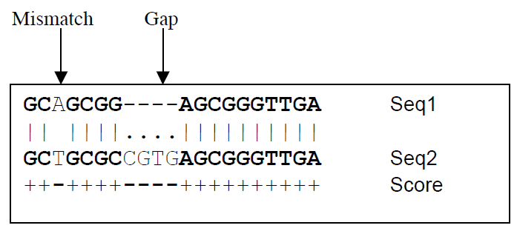
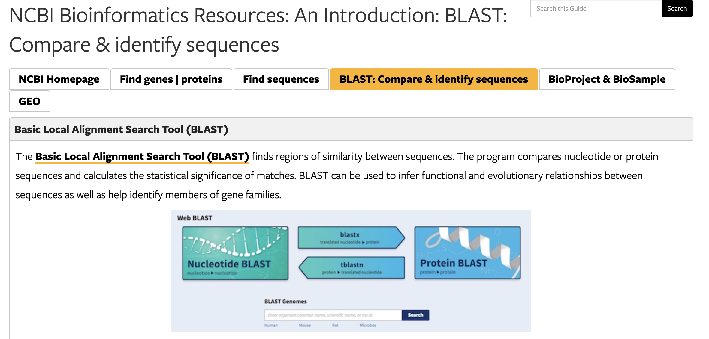
kNN
Real-world application : genetics
Newly discovered genes get classified based on their nearest neighbors
Specialized distance metrics because some areas of the sequence are known to be more important

Slide 24
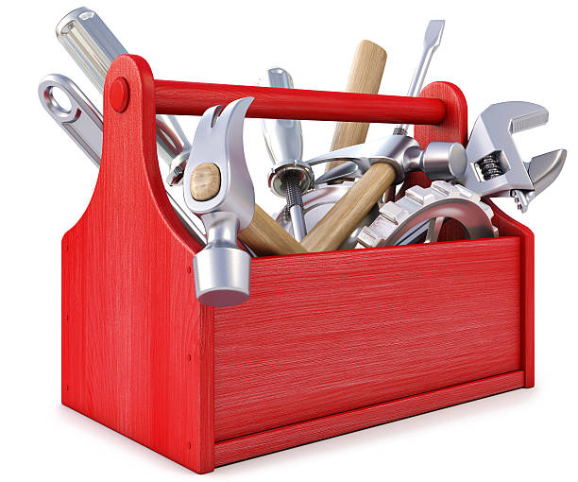
kNN as Regression model
kNN also works as a regression model
To get a prediction – use the average of the k nearest neighbors…
Finding the right k via cross-validation : use RMSE instead of error rate…
sklearn.kNeighborsRegressor

Slide 25
Unsupervised Learning - Clustering

Slide 26
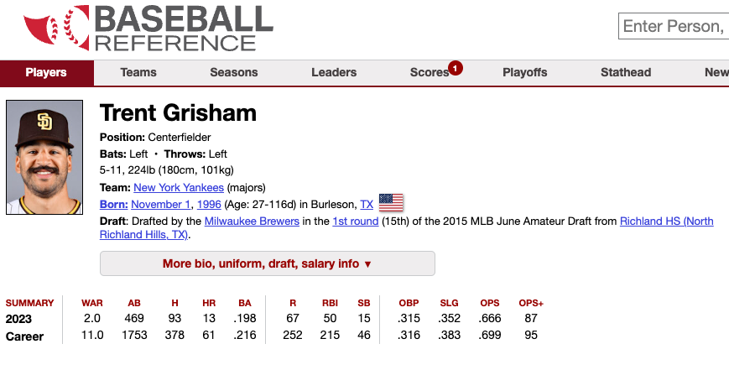
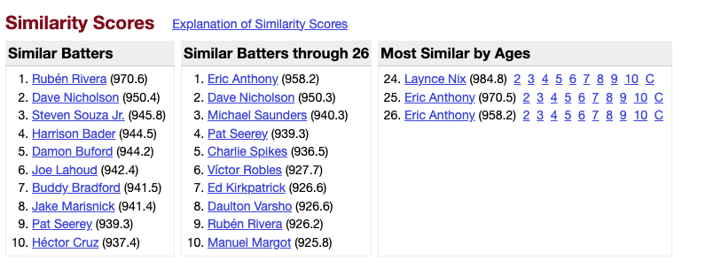
From Supervised to Unsupervised
The same ideas using similarities and differences for the purpose of classification can also be applied to unsupervised learning
Sometimes you might just be interested in exploring similarities:
https://www.baseball-reference.com/about/similarity.shtml

Slide 27
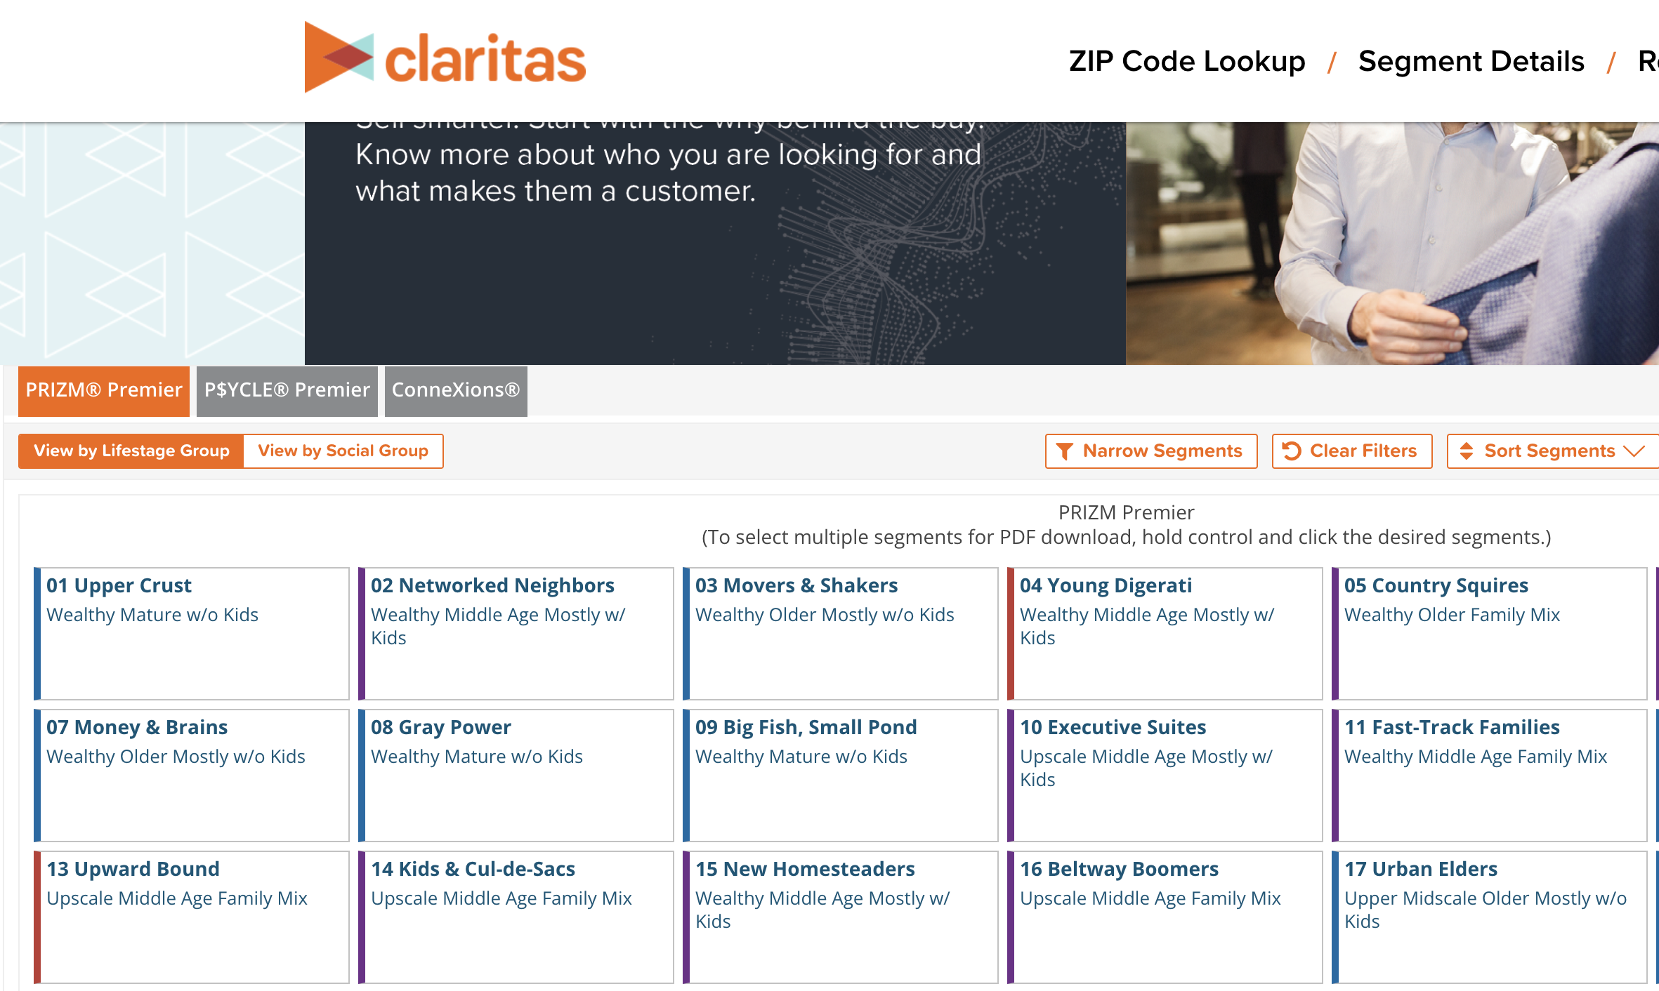
Clustering
Use data to automatically find interesting groupings of my data
Example: Claritas Customer Segmentation:
https://claritas360.claritas.com/mybestsegments
Notes:
By defining pre-set groups, no need to calculate all of the distances from everybody to everybody else.
Also, can combine with distances for a new customer.

Slide 28
Clustering
Question: How do I find (distinct) groupings of similar things?
“things” are objects with many features (multidimensional)
Key notions:
Define a similarity/distance metric between objects
Let the algorithm define clusters so the distance to things in a cluster are smaller than the distance between clusters
Two basic types of clustering:
Centroid based (a.k.a. Partitional)
Hierarchical
Notes:
Note: clustering assumes each point falls into

Slide 29
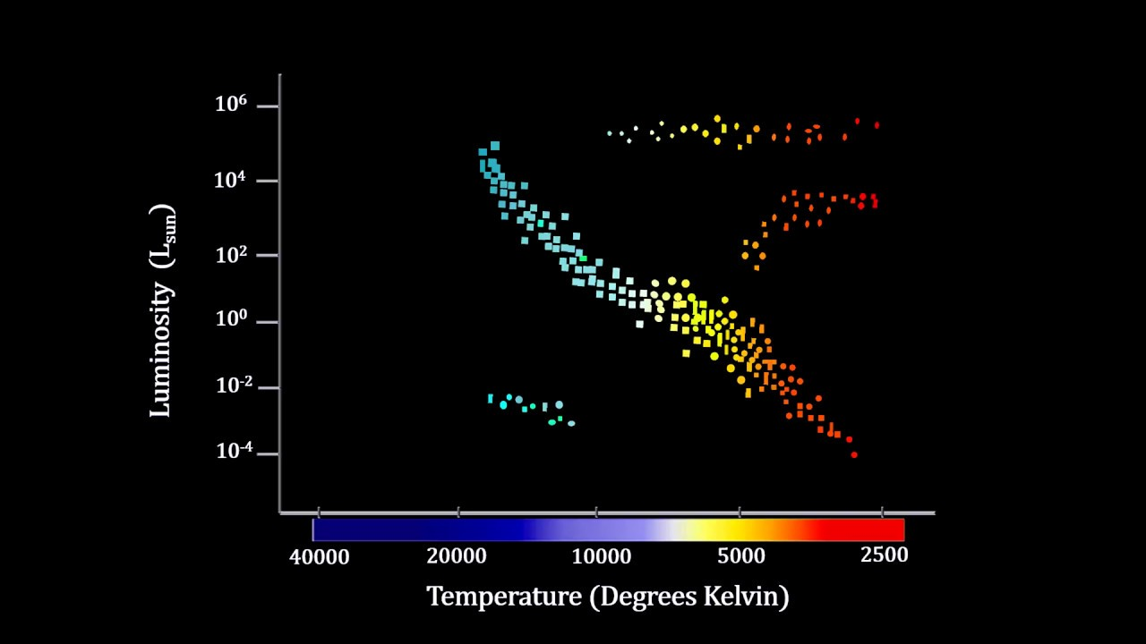
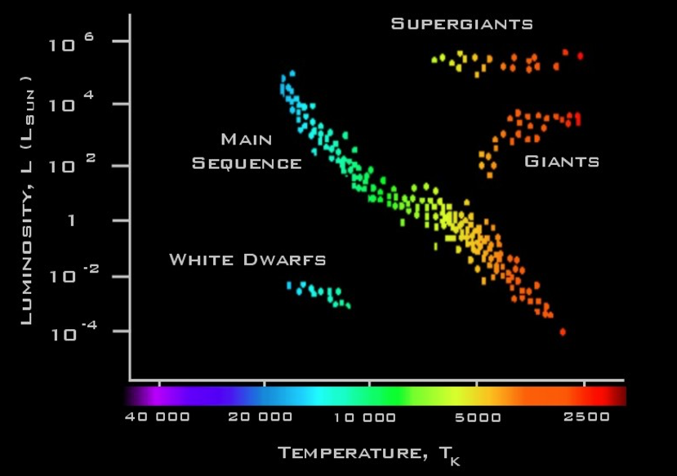
Clustering
Data sometimes (but definitely not always!) data falls into well defined clusters:
Hertzsprung – Russel diagram of stars
In this way, clustering can be a useful way of explaining data

Slide 30
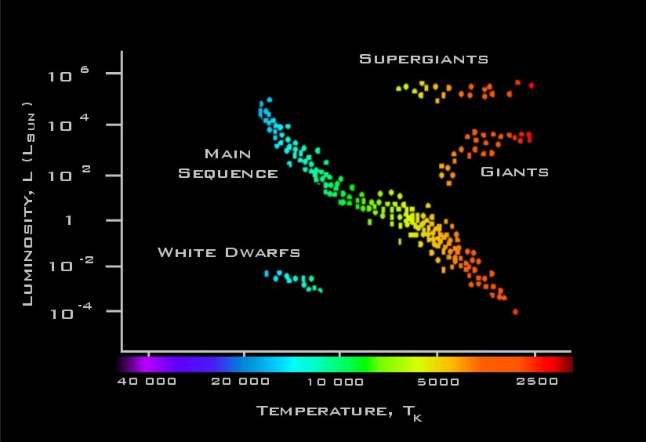
Clustering: Main idea
Ideally : create clusters of data items to achieve:
Maximum similarity between items within a cluster
Maximum dissimilarity between characteristics of different clusters
Intra-cluster distances are minimized
Inter-cluster distances are maximized

Slide 31
Clusters: k-means
One popular type of clustering is called “k-means clustering”
Again with the k!
k-means clustering:
Requires you to pick the number of clusters when you start – k!
Start with some guess as to the cluster centers
Iterate between
Classifying each point in one of the clusters
Recalculating cluster centers

Slide 32
K-Means
Predetermined
number of clusters
Start with seed centroids – random??
Seeds

Slide 33
Assign Instances to Clusters
Every point gets assigned to a cluster based on which centroid it is closest to

Slide 34
Find New Centroids
Calcuate the new centroids of the clusters

Slide 35
New Clusters
Repeat !!
Another example…

Slide 36
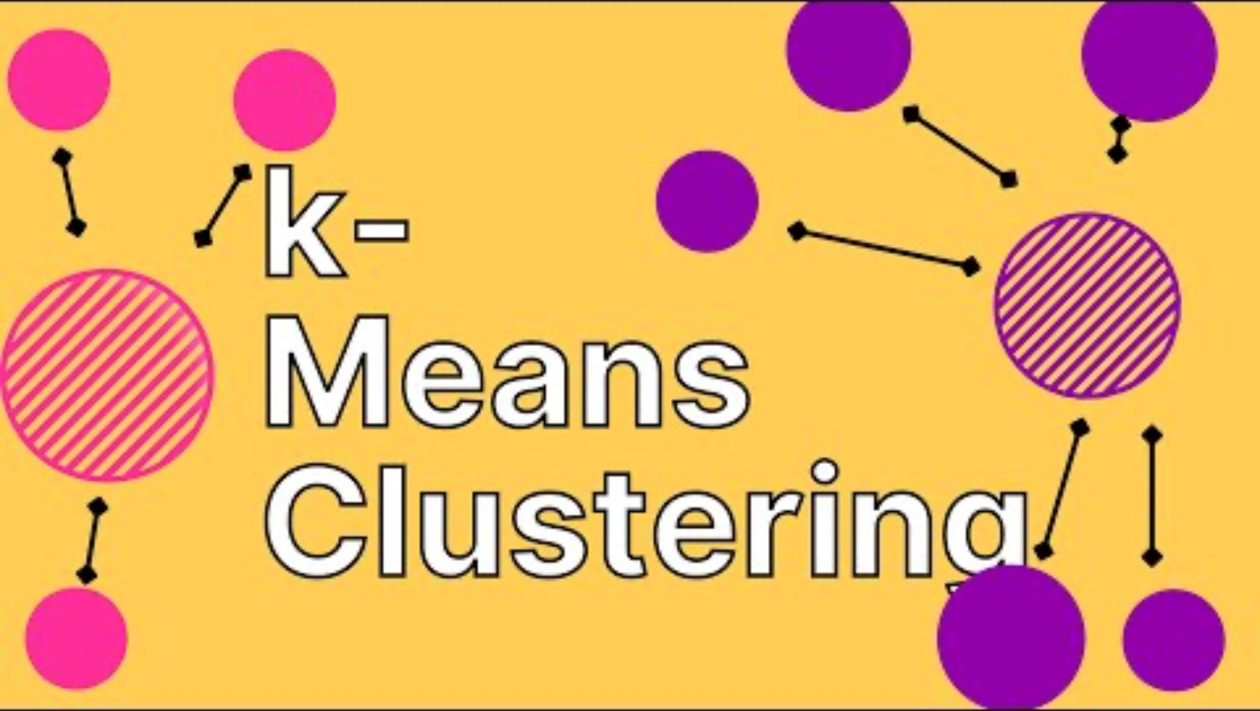
https://www.youtube.com/watch?v=DQTz7yVmz_g&t=103s (1:43)

Slide 37
How to pick k?
When you start with a data set you have no idea how many clusters there are!
Why cant we just select k via cross-validation???
One method plots the decrease in intra-cluster variance as k increases – called the “elbow” method.
Lets look at a case where it should be easy…
kmeans_Clustering. ipynb
Notes:
No cross-validation because there is no metric for success!!!

Slide 38
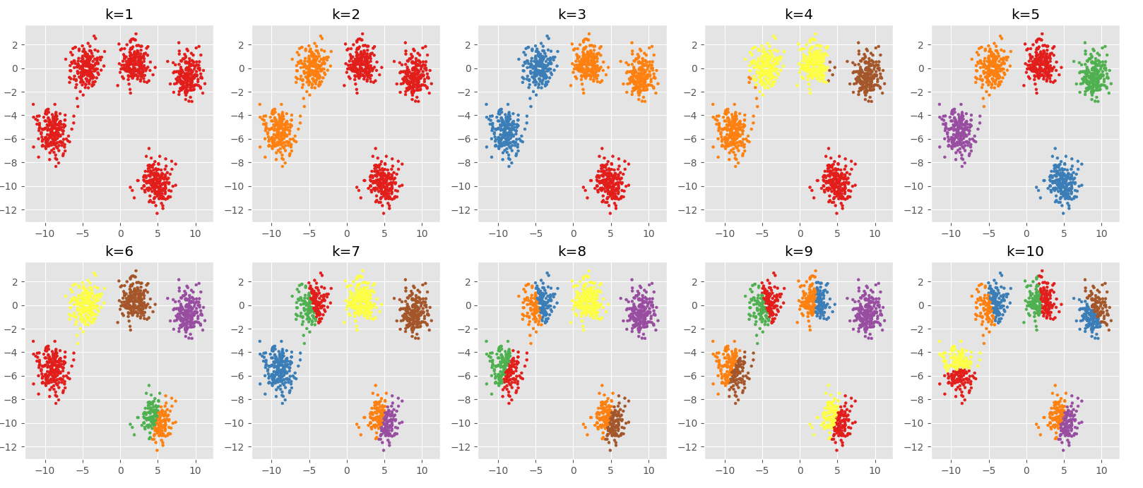
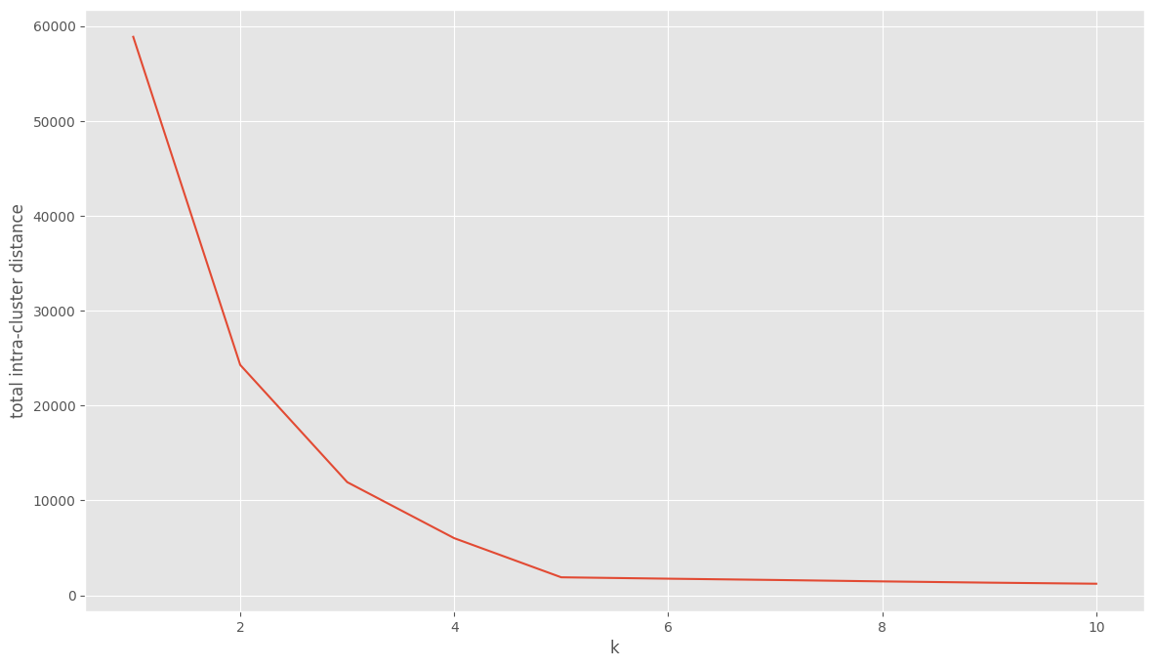
Data consists of 5 clusters
Fit k-means with k=[1,10]
”elbow” is where the curve starts to flatten, that is the optimal k
Intra-cluster variance
kmeans_Clustering.ipynb

Slide 39
K-means Clustering
kmeans_Clustering. ipynb

Slide 40
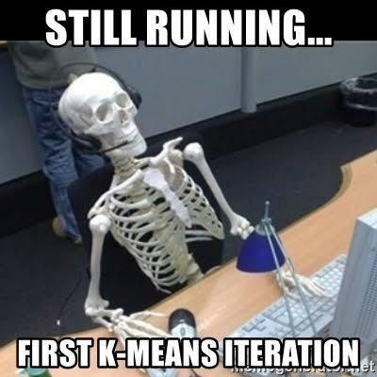
Discussion: k-means clustering
Data naturally does not cluster!!!!
But the algorithm will always find clusters….
Caveat emptor….
Sensitive to initial centers
n_init in sklearn implementation helps
Converges to a local optimum
Can run multiple times and get very different results
Specifying the number of centers very subjective
”elbow method” imprecise
sklearn.cluster.KMeans
Notes:
S in pybbb

Slide 41
Clustering: Hierarchical Clustering
Build a hierarchy of clusters from the bottom-up …
B
D
A
E
C
Start with n clusters, and progressively merge data until you have one cluster

Slide 42
Clustering: Hierarchical Clustering
A different philosophy on how to find clusters:
Generic Algorithm:
Compute all pairwise example-example similarities
Place each of n examples into a cluster of its own
Merge the two most similar clusters into one;
replace the two clusters by the new cluster
Repeat the above step until there are only k clusters left (note k could = 1).

Slide 43
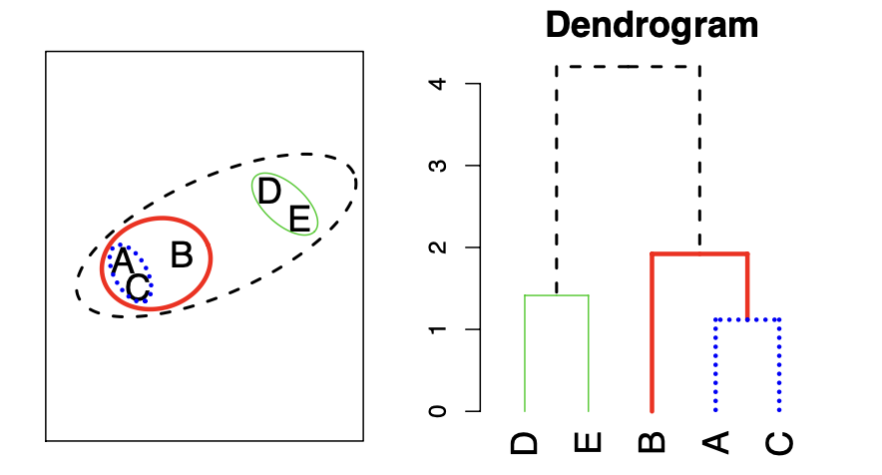
Dendrograms
Dendrograms are a visual representation of the hierarchical clustering process
Closest points get connected lower in the dendrogram

Slide 44
Dendrograms
Where you cut the dendrogram determines how many clusters you return:
This cut results in 2 clusters
This cut results in 6 clusters
You can partition your data into any number of clusters, from 1 to n

Slide 45
Make the Dendrogram!!
F
C
D
E
B
I
A
G
H

Slide 46
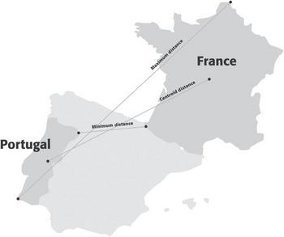
Hierarchical Clustering
Requires a metric for distance between clusters:
Maximum (complete linkage)
Distance between clusters is the maximum distance between two points
Minimum (single linkage)
Distance between clusters is the minimum distance between two points
Average
Distance is the average of all distances
Centroid
Distance is the distance between the centroids
Shmueli Ch 15

Slide 47
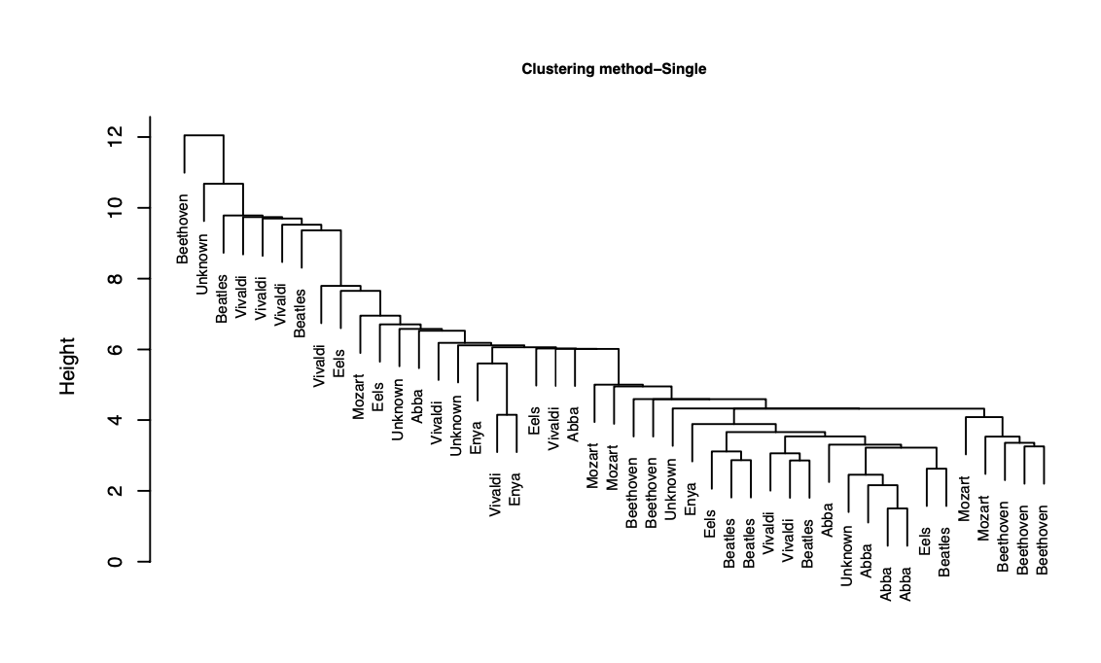
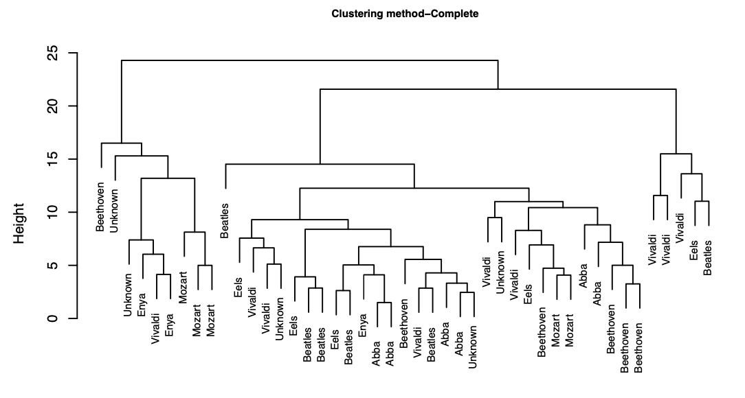
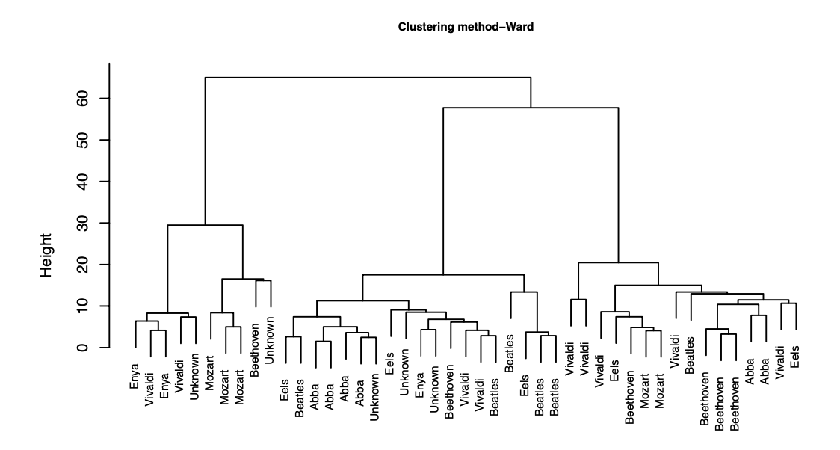
Hierarchical clustering – Music Example
Clustering can look very different under different linkages!
Single
Complete
Ward
Another approach:
Ward’s method: a way of doing Hierarchical clustering – merging is decided based on increase in within-cluster variance

Slide 48
Hierarchical Clustering
HierClust.ipynb

Slide 49
Beware Clustering
Very hard to evaluate clustering output! Consider the following:
Cluster interpretability – did you find anything interpretable?
Cluster stability – do your clusters change with different inputs?
Cluster separation – does there really seem to be a difference between the clusters in a meaningful way?
Number of clusters – did you end up with enough to be meaningful in a business sense?
There are so many different levers to pull, and so little way to evaluate it!
It can be mis-used…algorithms will always reveal clusters, even if there is no real clustering in the data
Or just use as an exploratory measure to find interesting signal or to inspire other work.

Slide 50
Class Data
T9_ClassSimilarities.ipynb

Slide 51
Summary – Topic 9
Similarities
Many different ways to calculate similarities (and differences!) between data points
K-nearest neighbors
A useful method for classification that doesn’t involve fitting a model
Clustering
Unsupervised learning method to find groups in data
K-means
Iterative clustering algorithm that finds groups using distances and a given k
Hierarchical clustering
Clustering algorithm that builds a nested sequence of clusters, allowing one to choose any possible k

